Slide 1
Website Menu
Home – slides 1-4
Each picture should be a live link that takes user to that page.
Menu Features– slide 5
Coffee collection
Our story
Locations
http://spm-sites.com/ct/
Social media

Slide 2





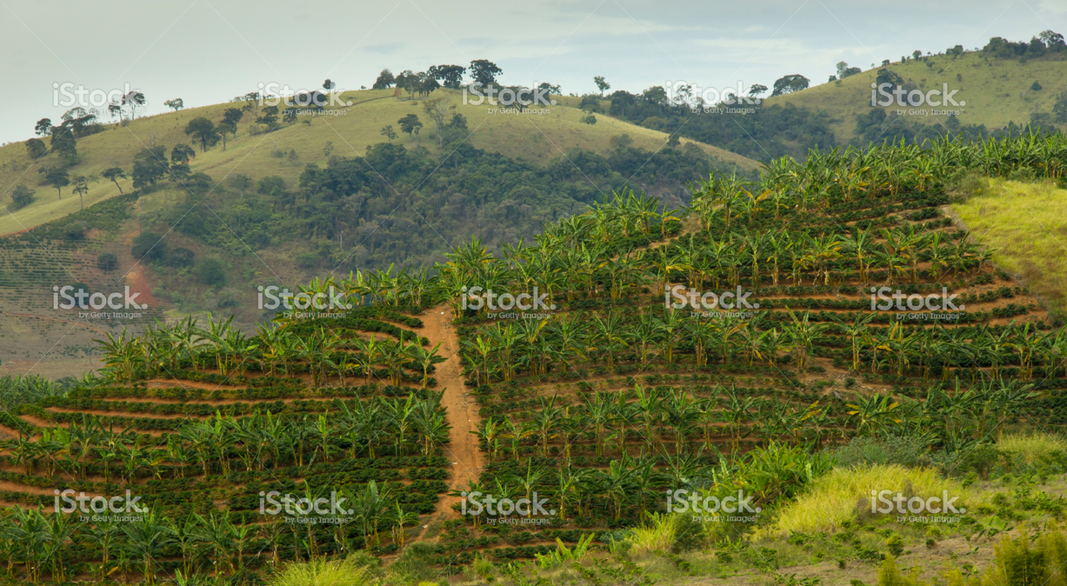
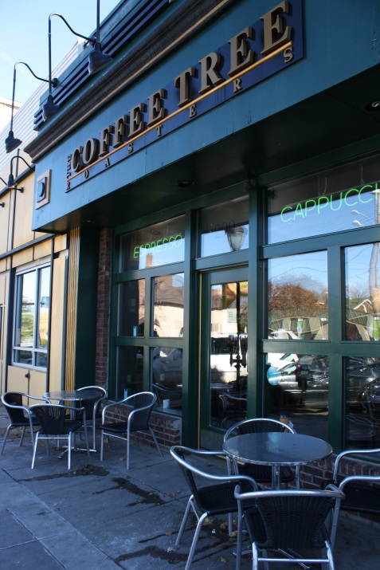
Locations
Coffee Fresh Off The tree

Slide 3
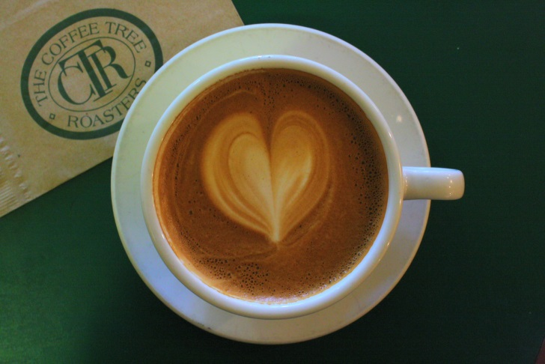
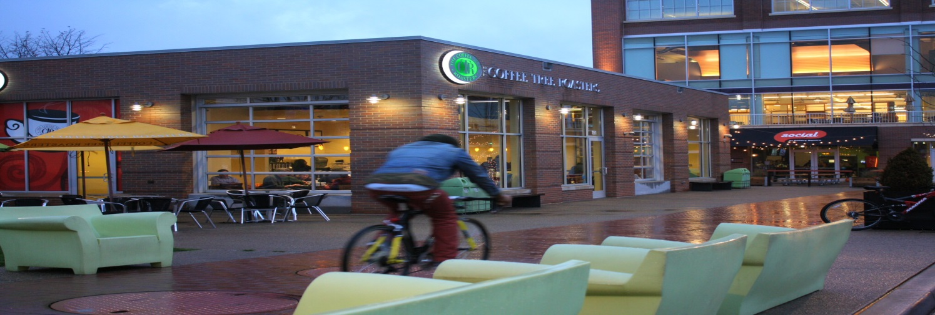
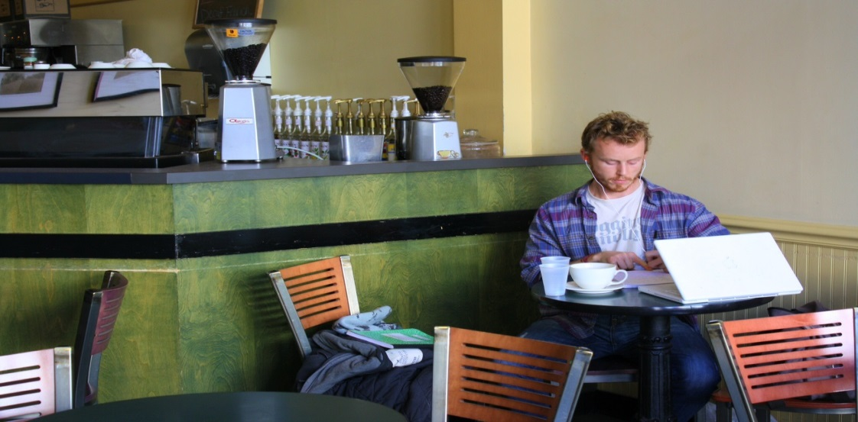
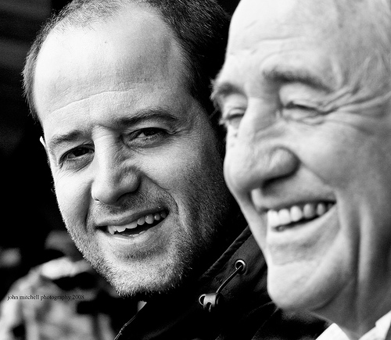

Coffee Fresh From The tree
In Our Locations
See Our Collection
Shared on Social Media
Through
Our Story

Slide 4
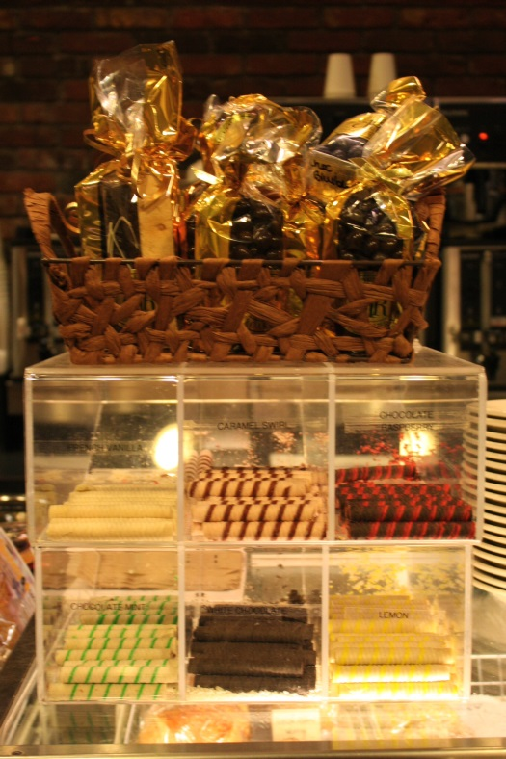
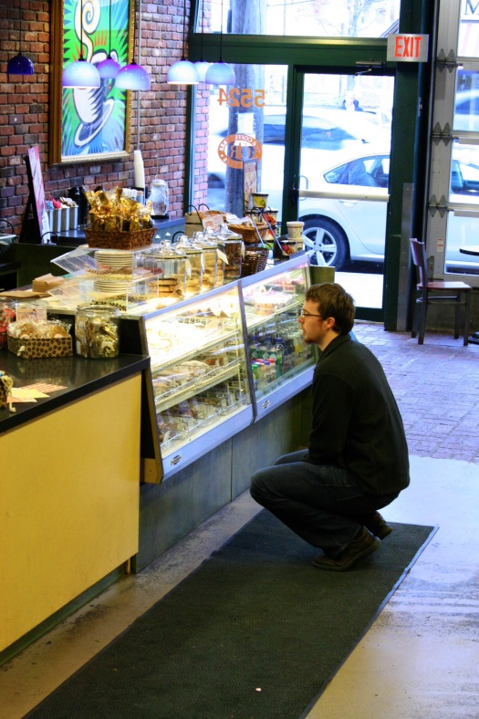
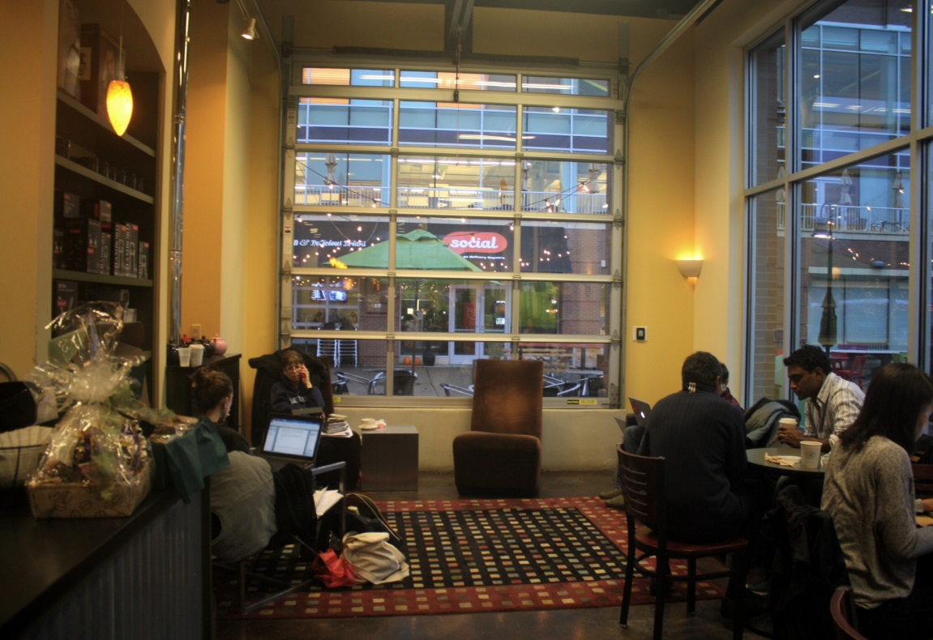
While You Enjoy Eats & Treats
In A Comfy Environment

Slide 5
Menu Items that should be listed. It needs to look like a board on the wall. You can see images in the footage.

Slide 6
8 Days: How We Keep It Fresh
Coffee is an exciting journey that has takes its drinker from the aromatic jungles of Colombia to the complex mountain ranges of Ethiopia. A beautifully brewed cup of coffee begins with the origin and quality of the beans. Here at Coffee Tree Roasters, our green coffee buyer and President, Bill Swoope Jr., travels globally in constant search of the highest quality coffee beans and brings them straight to coffee lover here in Pittsburgh.
Roasting fresh coffee is an art we have spent many years perfecting that we are pleased to share with you every day. People often underestimate the role roasting plays in the freshness and flavor of the coffee, but as the experts we want coffee lovers to know, it’s everything! Roasting methods help determine the flavor of the final brewed cup of coffee, but done incorrectly it can completely burn the beans leaving them beyond brew able. Roast Masters
Image of Bill picking out coffee beans
Green coffee buyers travel the world testing different coffees and working with producers to achieve the highest quality possible.
Image of a roast master, coffee roaster, and coffee being roasted
Our Roast Masters unparalleled skill set and traditional hands-on roasting method generates perfectly, roasted coffee ready to come home with you.
Image of person buying a bag of coffee in the store.
After roasting, our coffee is stored in airtight containers and scooped into a bag upon purchase. To maintain the ultimate freshness, any coffee that is not sold after 8 days of roasting, is discarded. This is How We Keep It Fresh!
Split Image: Left Side of The Roasters, Right Side of employee scooping and bagging the coffee.

Slide 7
Good or used photos for sure
98
112
113
90
87
http://www.istockphoto.com/photo/banana-and-coffee-plantation-44341764?st=716ed98

Slide 8
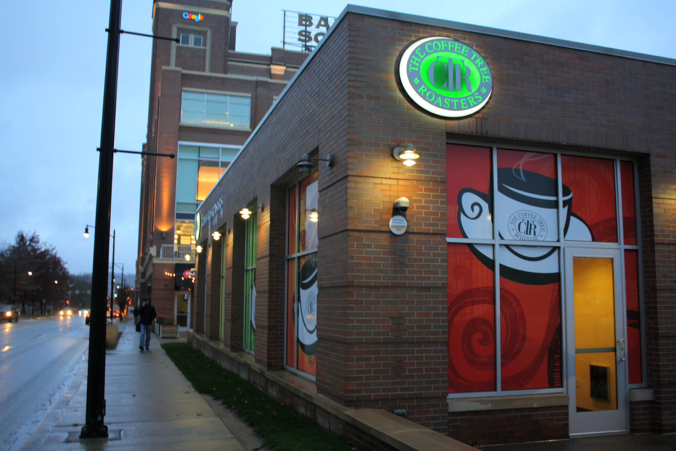



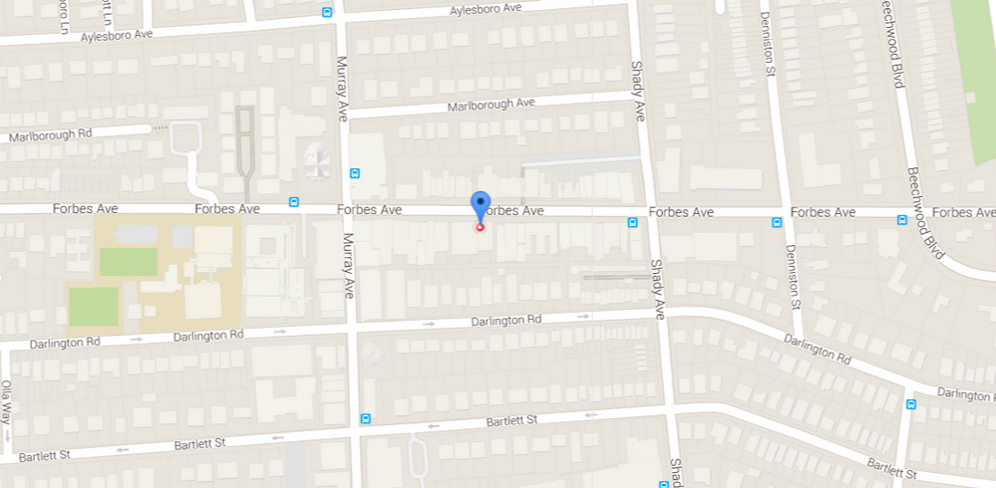

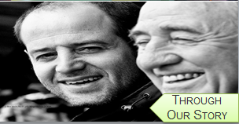

Squirrel Hill
Social media

Slide 9



Options for Facebook share coffee

Slide 10
Footer
Site map
Location page links
Return policy
Privacy Polcy – from google
Allergen Statement

